Slide 1
introduction to git
richard cirerol
http://spkr8.com/t/5760

Slide 2
Bio
richard cirerol
working gig:
sr. software developer at unity media group
independent contractor (code progression llc)
speaking gigs:
boise .net developer user group (netdug)
boise and portland code camps
writing gigs:
elegantcode.com
codeprogression.com

Slide 3
git
why?
cheap local branching
everything is local
git is fast
git is small
the staging area
distributed
any workflow
github
easy to learn
source: http://whygitisbetterthanx.com/

Slide 4

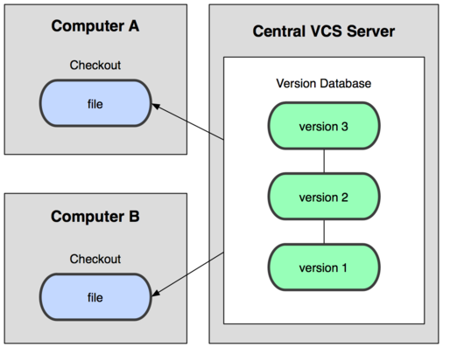
versioning
(cc) http://progit.org/figures/ch1/18333fig0102-tn.png

Slide 5

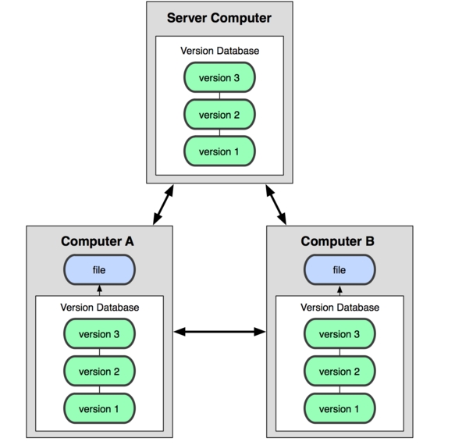
versioning
(cc) http://progit.org/figures/ch1/18333fig0103-tn.png

Slide 6
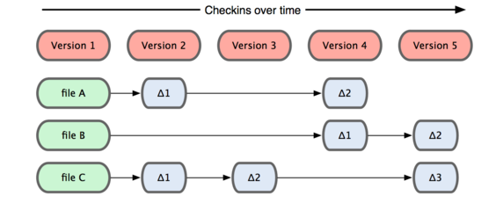
versioning
(cc) http://progit.org/figures/ch1/18333fig0104-tn.png

Slide 7
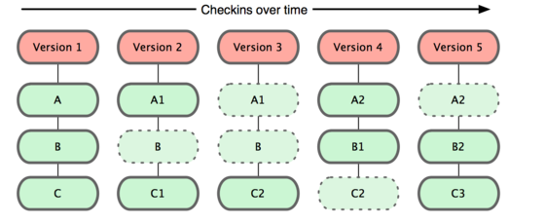
versioning
(cc) http://progit.org/figures/ch1/18333fig0105-tn.png

Slide 8
tools for windows users
git extensions
msysgit
git source control provider
vscommands lite (technically not a git tool, but helpful when changing branches)
Source: http://devlicio.us/blogs/krzysztof_kozmic/archive/2011/01/26/git-tooling-for-net-developers.aspx

Slide 9
tools for mac users
gitk
gitgui
gitx
gitnub
eclipse plug-in
Source: http://gigaom.com/apple/using-git-with-os-x-6-tools-to-get-you-up-and-running/

Slide 10
basic commands
git init
git clone
git branch
git checkout
git add
git commit
git status
git diff
git reset
git merge
git rebase
git stash

Slide 11
basic git workflow
git init
git remote add
* git checkout –b
git add
git commit
* git merge
git push

Slide 12
demo
create repository
make some changes
commit and deploy

Slide 13
git-svn
why?
cheap local branching
everything is local
git is fast
git is small
the staging area
distributed
any workflow
github
easy to learn

Slide 14
basic git-svn commands
git svn init
git svn clone
git svn fetch
git svn rebase
git svn dcommit

Slide 15
basic git-svn workflow
git svn init
git svn fetch -r
git checkout -b
git add
git commit
git svn rebase -i
git svn dcommit
warning!
do not use git to do svn merges or branch reintegrations

Slide 16
demo
clone subversion repository
make some changes
commit

Slide 17
services
http://github.com
http://codaset.com
http://repositoryhosting.com
http://appharbor.com

Slide 18
resources
progit book http://progit.org/book/
why git is better than x… http://whygitisbetterthanx.com
everyday git with 20 commands or so http://www.kernel.org/pub/software/scm/git/docs/everyday.html
using git with subversion
http://andy.delcambre.com/2008/03/04/git-svn-workflow.html http://www.viget.com/extend/effectively-using-git-with-subversion/
documentation
https://git.wiki.kernel.org/index.php/GitDocumentation
videos
http://gitcasts.com
tutorials
http://gitimmersion.com/

Slide 19
@richardcirerol
elegantcode.com
http://spkr8.com/t/5760
content from progit book shared under creative commons attribution-non commercial-share alike 3.0 license (http://creativecommons.org/licenses/by-nc-sa/3.0/us/)

